Slide 1

Test Driven Development test
By Rikke Domino Isaksen

Slide 2
What is TDD?
TDD stands for Test Driven Development
It is a way to think through your requirements or design before you write your functional code.
But it is also a programming technique, where the goal is to write clean code that works.

Slide 3
TDD is about making small test through your code

Slide 4
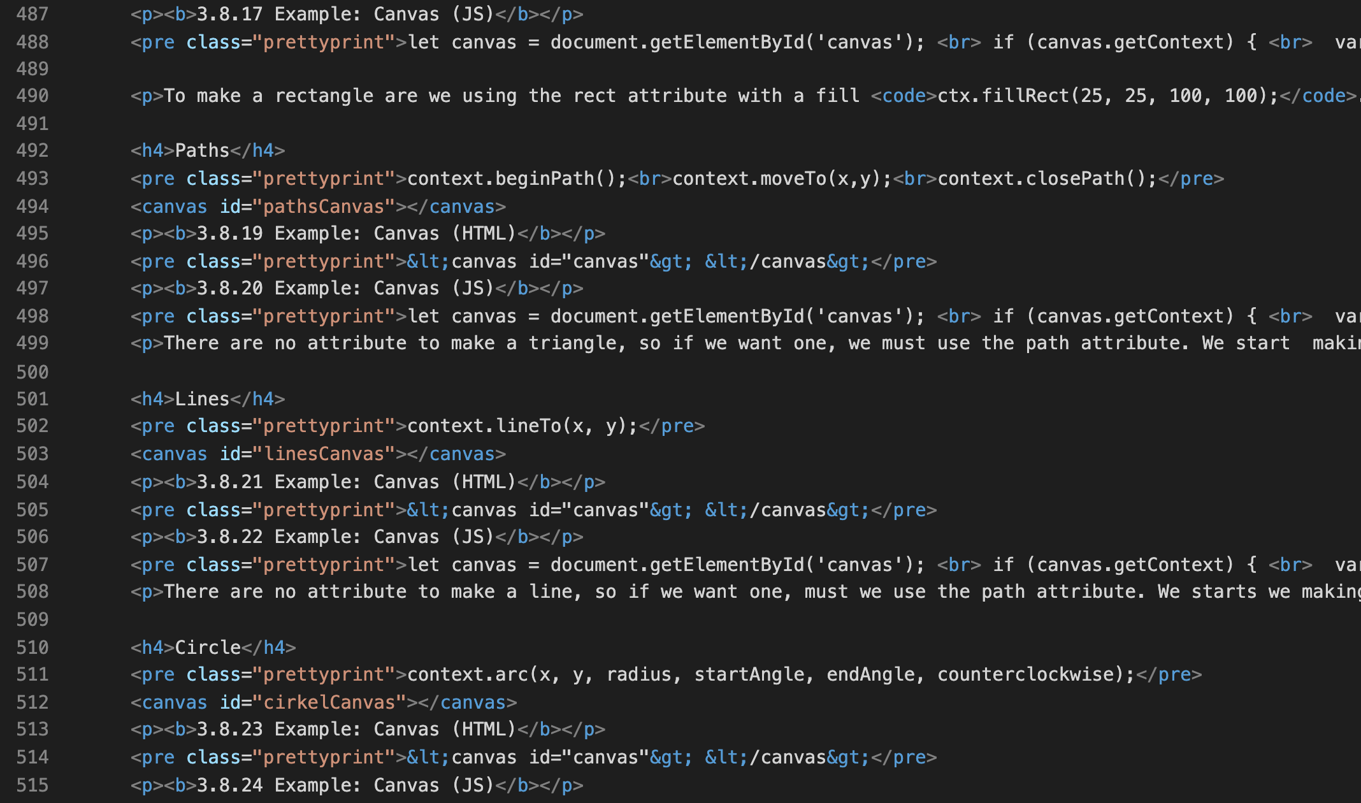
If we got a task to add some code to this file..
Notes:
A significant advantage of TDD is that it enables you to take small steps when writing software. This is a practice that I have promoted for years because it is far more productive than attempting to code in large steps. For example, assume you add some new functional code, compile, and test it. Chances are pretty good that your tests will be broken by defects that exist in the new code. It is much easier to find, and then fix, those defects if you’ve written two new lines of code than two thousand.

Slide 5
Should we write 20 lines of code and then test if it works? Or write 2 lines, test if it works, then write 2 lines more and test again?
Notes:
A significant advantage of TDD is that it enables you to take small steps when writing software. This is a practice that I have promoted for years because it is far more productive than attempting to code in large steps. For example, assume you add some new functional code, compile, and test it. Chances are pretty good that your tests will be broken by defects that exist in the new code. It is much easier to find, and then fix, those defects if you’ve written two new lines of code than two thousand.

Slide 6
Why should we use this method?
Easy refactoring and code maintenance
Prevents bugs

Slide 7
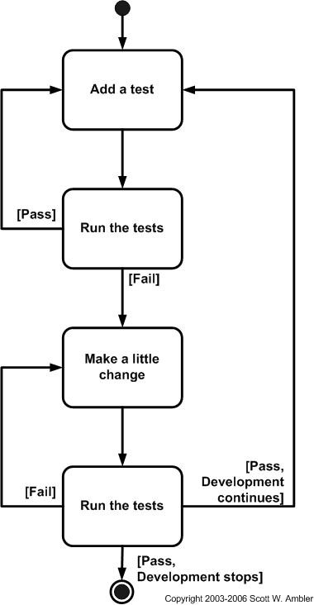
How to do it?
Write a test
Confirm the test fails
Write code to pass the test
Confirm the test passes
Refactor
Repeat all steps

Slide 8
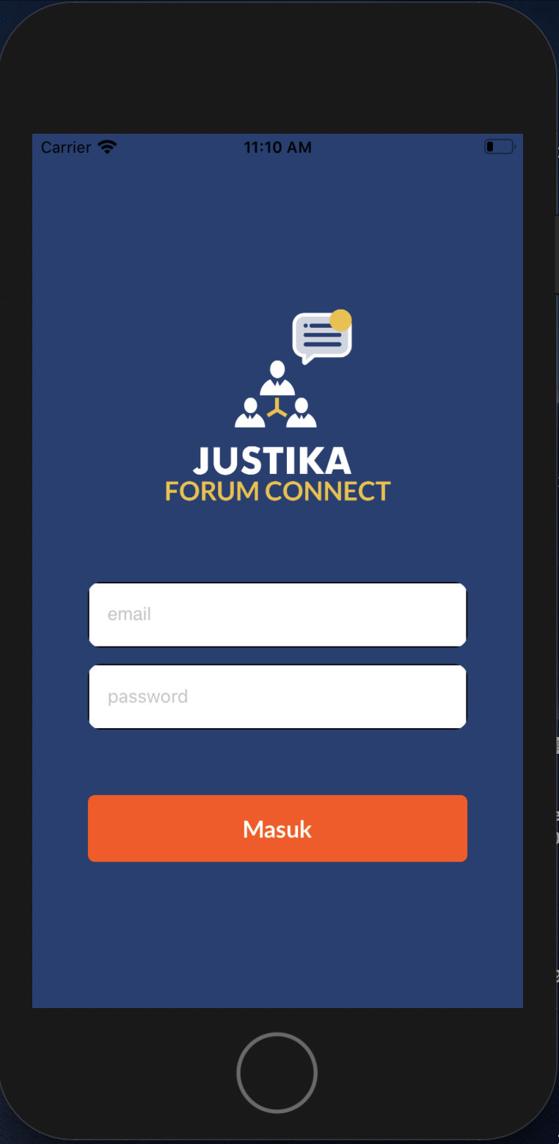
Here is an example…
We want to build this login page. Before we make the page, we create the test.

Slide 9
What to make?
We can see that there are 3 UI elements that need to be tested. They are email and password text field and ‘Masuk’ button.

Slide 10

What to make?
To test them we need to make them in your editor.
But how do we test it?

Slide 11
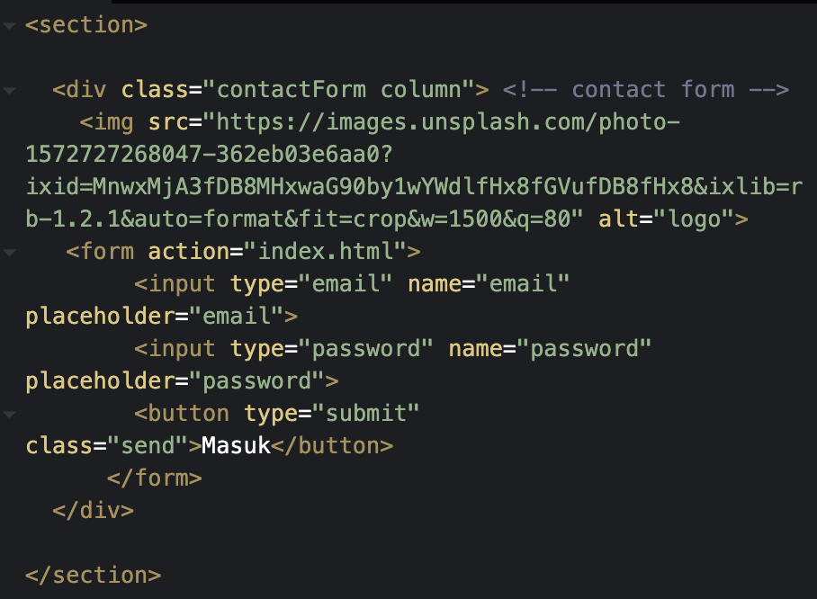
How to test it?
We have written the HTML code, before we write CSS we need to test if there are any errors. Are the contact form visible on the site?

Slide 12
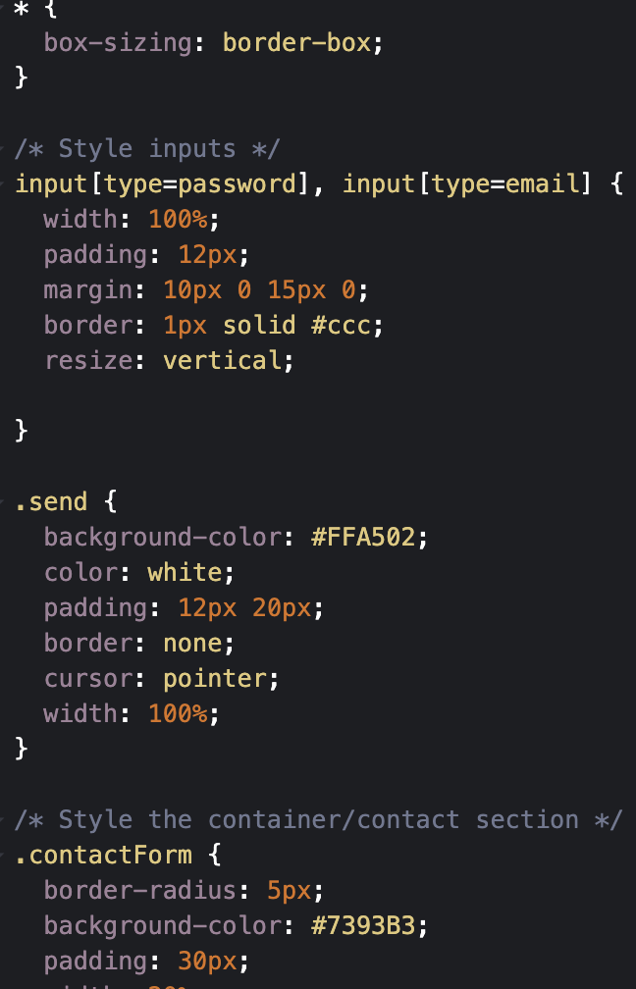
How to test it?
It works, if the contact form are visible and you can press the submit button.
Now is it time to make the CSS part.

Slide 13
Literature
Test it before you make it. Avaliable online < https://uxdesign.cc/test-it-before-you-make-it-7e0e07af4841 >

